Slide 1

Online Book Recommendation System Using KNN Algorithm

Slide 2
Overview:
A recommendation system is one of the top utilizations of data science. Each shopper Internet organization requires a recommendation system like Netflix, Youtube, a news source, and so forth.
A book recommendation system can consider numerous boundaries like book content and book quality by sifting client reviews and top ratings of books purchased on old browsing history In the segment underneath, I will acquaint you with an AI project on the book recommendation system utilizing Python.

Slide 3
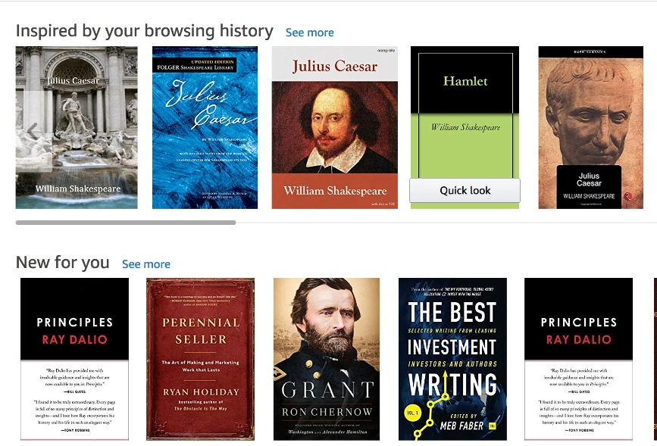
Online recommendation system
A book recommendation system is intended to prescribe books important to the buyer.

Slide 4
Background and motivation
The motivation behind a book recommendation system is to foresee purchaser's advantage and prescribe books to them in like manner.
In this paper we propose utilizing recommendation frameworks for suggesting books. We fostered a framework, which learns client inclinations by requesting to rate books and picking most loved classes and afterward produce the rundown of books client most presumably might want to peruse.

Slide 5
INTRODUCTION:
Proposal frameworks were advanced as keen calculations, which can create brings about the type of suggestions to clients. They diminish the above related with settling on best decisions among the bounty. Presently, Recommender frameworks can be carried out in any area from E-COMMERCE to security.

Slide 6
organize security as customized administrations. They give advantage to both the customer and the maker, by recommending things to shoppers, which can't be requested until the recommendations[1].These days how much data particularly in Internet development quickly. Finding essential data becomes more troublesome. Proposal frameworks plan to settle this sort of issues[2].In the event that we take every one of the books and every one of the users for modeling.

Slide 7
Problem statement
Don't you suppose will it create a problem? So what we have to do is we have to decrease the number of users and books because we can't consider a user who has just registered on the website or has just read one or two books.

Slide 8
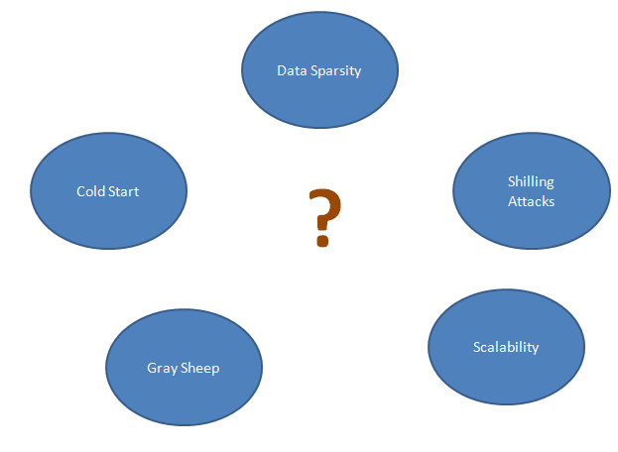

Slide 9
Related work
Over the most recent 20 years there has been a considerable growth in the field of recommender systems. The research works like . The objective of the most recommendation system is to predict the buyer's interest and recommends the books appropriately. This book recommendation has considered numerous parameters like content of the book and nature of the book by doing collaborative filtering of ratings by the other buyers [1][2].

Slide 10
Presently, Recommender systems can be implemented in any space from E-commerce to network security as personalized services. They provide benefit to both the consumer and the manufacturer, by suggesting items to consumers, which can't be demanded until the recommendations[3].

Slide 11
Bigger the quantity of normal clients higher will be the JS Index and subsequently better suggestions. Books with high JS index (more suggested) will show up on top of the suggested books list[4].
These frameworks are comprehensively characterized into collaborative filtering (CF) and content-based filtering (CB). CF is a data filtering practice that is based on the client's assessment of things or past buys records[5][6].

Slide 12
Methodology
Book Recommendation System with python. i have used item based collaborative filterinhg approach as follows , In this section, I will take you through how to construct a Book recommendation system with Machine Learning utilizing Python. I will start this errand by bringing in the necessary Python libraries and the dataset:

Slide 13
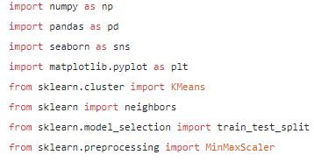

Slide 14
Dataset: books.csv
Description: book dataset contains the following attributes information:
1.bookID
2.title
3.authors
Average Rating
isbn
isbn13
language code
num_pages
ratings_count
text_reviews_count
publication_date
publisher

Slide 15
Data Exploration:
The dataset that contains data about the books, who wrote these books and other relevant data.
We have used only top 10 ratings
Ranking of data is found using data present in book file

Slide 16
will attempt to use this column to find the most commented books present in our data
Here we creates the binary data frame to assign the rating values to the groups accordingly:
It includes the following data:
Rating df
Average grade
Number of grades

Slide 17

The algorithm will find the median for all and equalize it
KNN algorithm implementation:

Slide 18
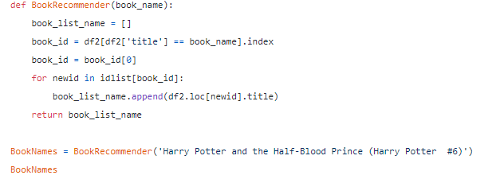
The model build the list on the basis of different features of books:

Slide 19
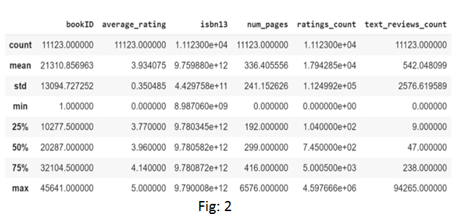
Results: following are the results for the given implementation of the book recommendation system:

Slide 20
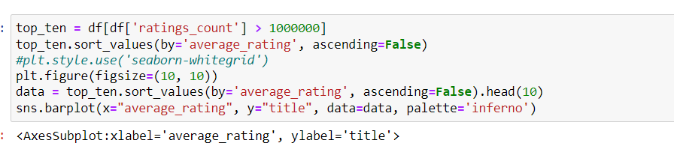

Slide 21
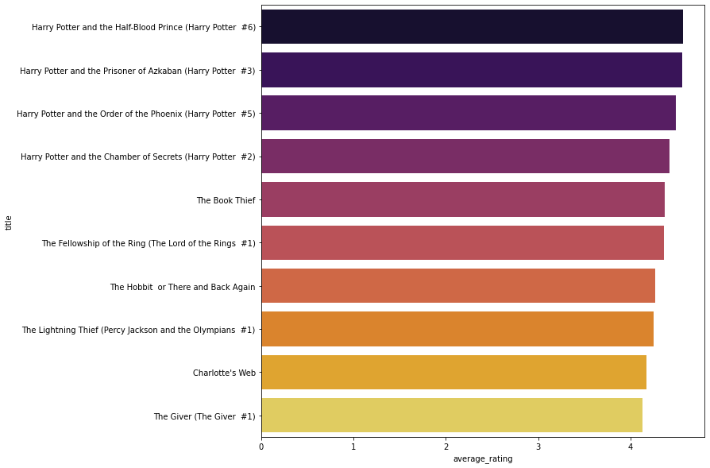

Slide 22
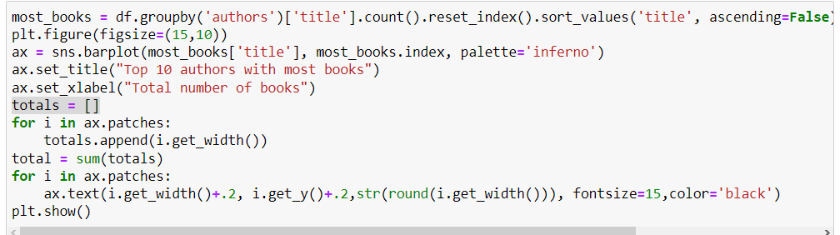

Slide 23
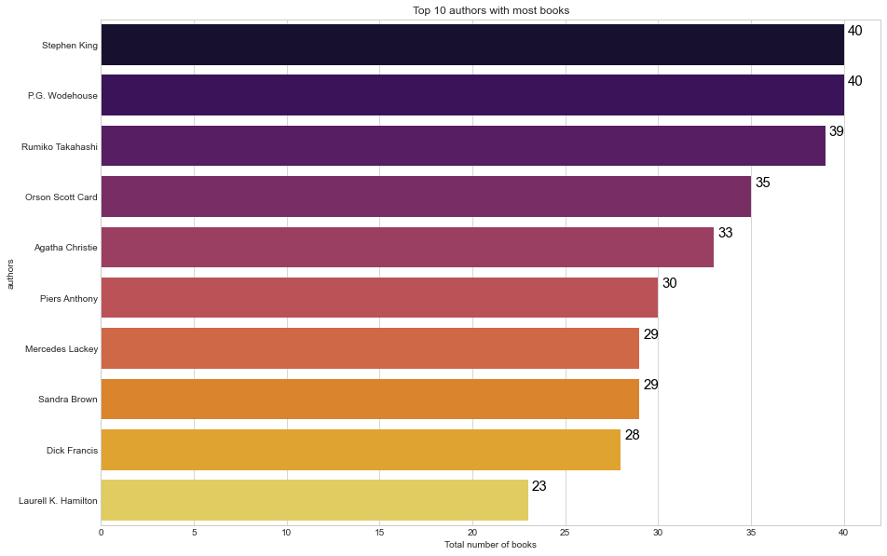

Slide 24
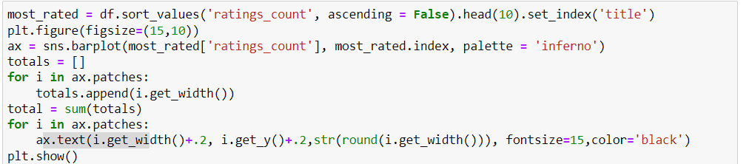

Slide 25
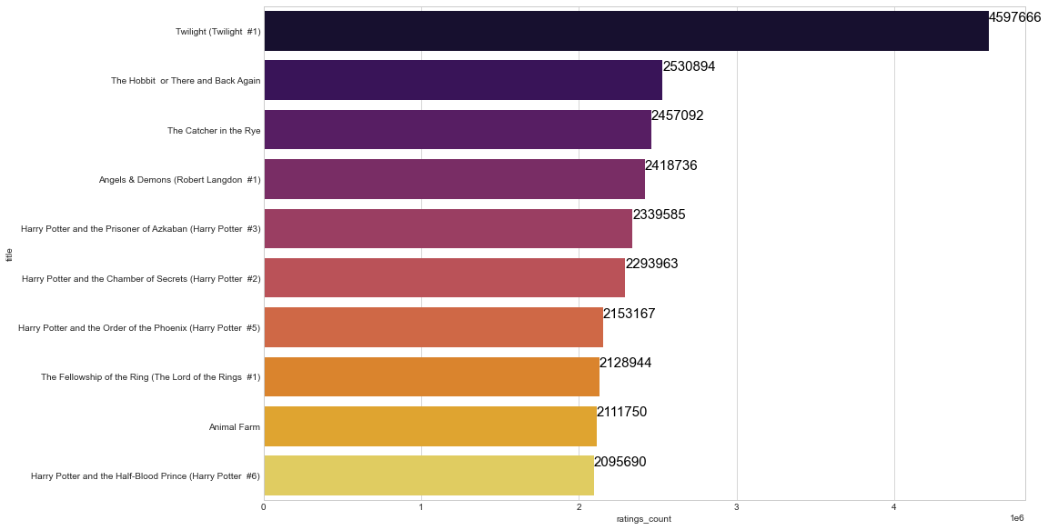

Slide 26
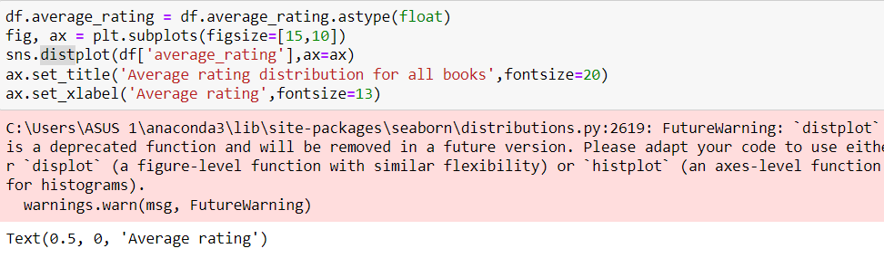

Slide 27
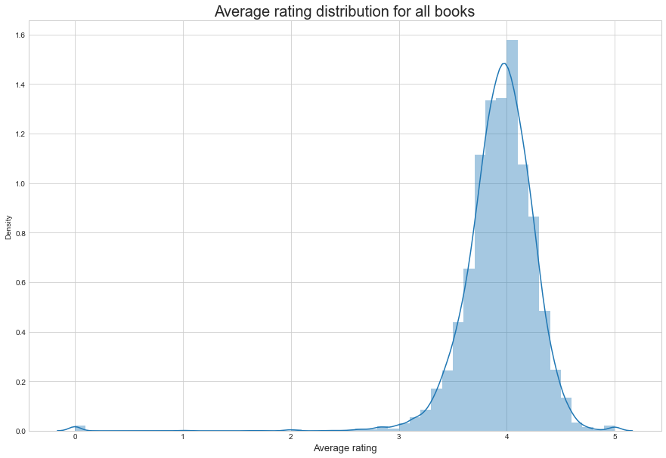

Slide 28
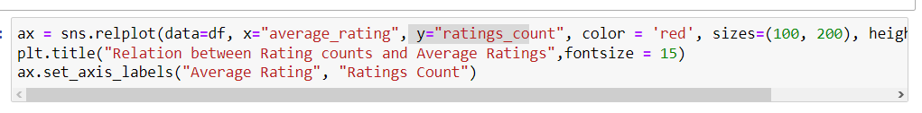

Slide 29
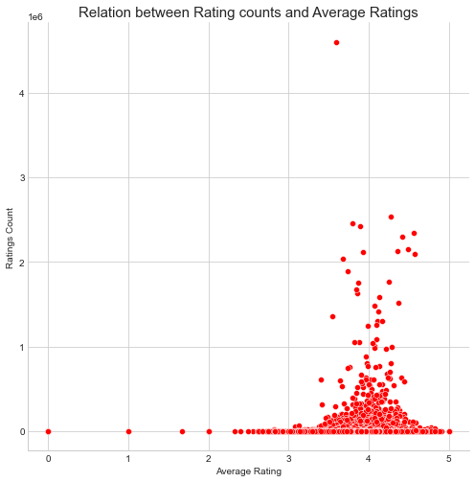

Slide 31
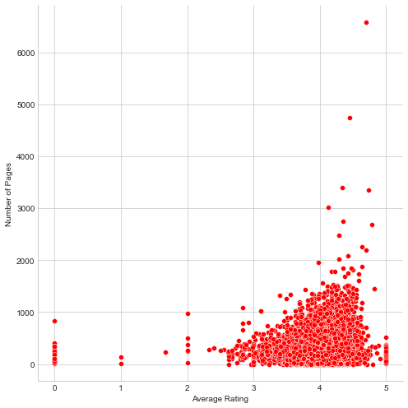

Slide 32
We can see that Twilight has been rated more times than any other book! Also, these ratings are all in the millions! So that means Twilight has been reviewed over 4 million times, followed by The Hobbit or There and Back Again and The Catcher in the Rye which has been reviewed over 2 million times. Track down a relation between our average score and the number of scores.

Slide 33
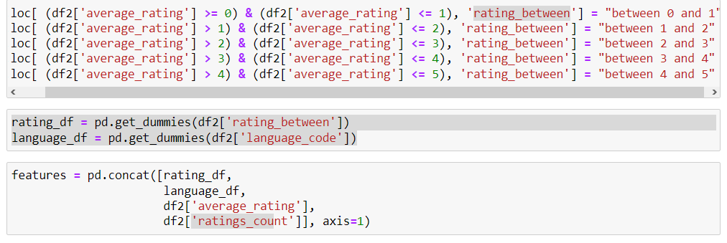

Slide 34
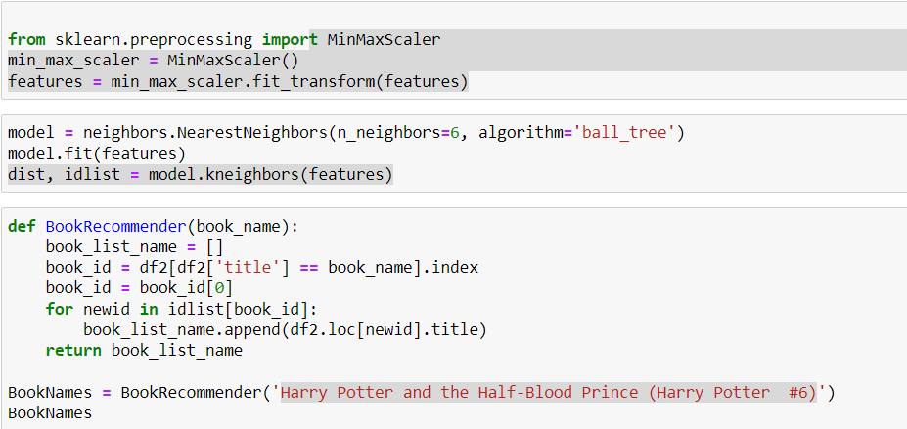

Slide 35
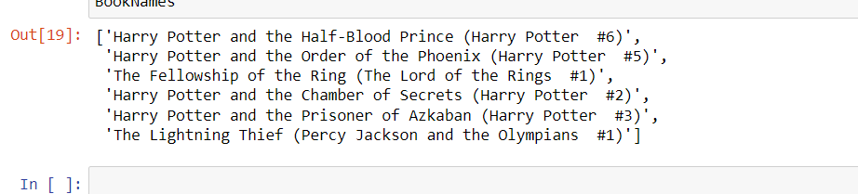

Slide 36
Final step, We have developed a machine learning model for recommending books and presently we should make a function utilizing Python.
At the point when this function is called, we should pass the name of the book to it. The model will attempt to find books in light of the elements. We'll store those book names that the framework suggests in a rundown and return them toward the end.

Slide 37
Conclusion
The heightening requests of Online Data have prompted the innovation of new strategies for introducing or rather prescribing various items to the clients. This paper involves Collaborative filtering also Association data Mining to prescribe various kinds of books to the clients. Both these procedures make a decent Hybrid Recommendation System and furthermore disposes of the Data Sparsity and Cold Start problem. At last, the estimations of both the algorithms give exact outcomes.

Slide 38
References:
1:Rajpurkar, S., Bhatt, D., Malhotra, P., Rajpurkar, M.S.S. and Bhatt, M.D.R., 2015. Book recommendation system. IJIRST–International Journal for Innovative Research in Science & Technology, 1(11), pp.314-316.
2.Kurmashov, N., Latuta, K. and Nussipbekov, A., 2015, September. Online book recommendation system. In 2015 Twelve International Conference on Electronics Computer and Computation (ICECCO) (pp. 1-4). IEEE.
3.Mathew, P., Kuriakose, B. and Hegde, V., 2016, March. Book Recommendation System through content based and collaborative filtering method. In 2016 International conference on data mining and advanced computing (SAPIENCE) (pp. 47-52). IEEE.
4. Rana, Avi, and K. Deeba. "Online book recommendation system using collaborative filtering (with Jaccard similarity)." Journal of Physics: Conference Series. Vol. 1362. No. 1. IOP Publishing, 2019.
5. Patil, Abhay E., et al. "Online book recommendation system using association rule mining and collaborative filtering." International Journal of Computer Science and Mobile Computing 8.11 (2019): 83-87.
6. Thorat, Poonam B., Rajeshwari M. Goudar, and Sunita Barve. "Survey on collaborative filtering, content-based filtering and hybrid recommendation system." International Journal of Computer Applications 110.4 (2015): 31-36.

Slide 39
Thank you !

